Slide 1
Machine Learning (ML)
Theory and Concepts

Slide 2
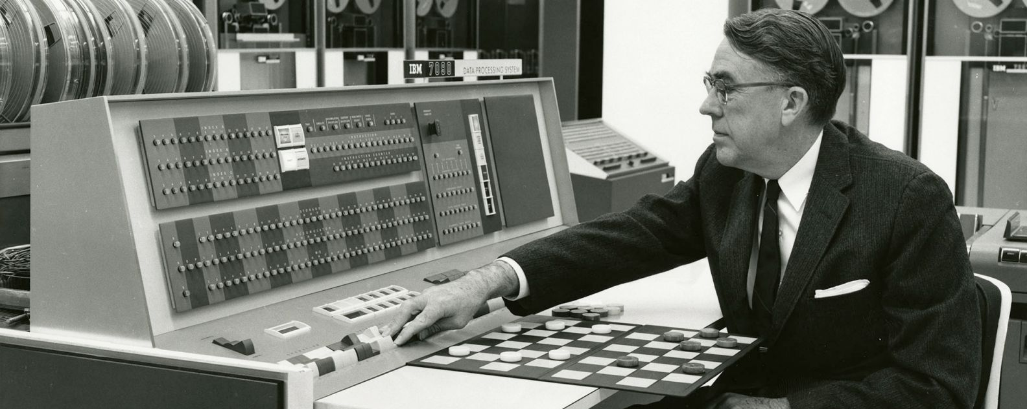
Arthur Lee Samuel (December 5, 1901 – July 29, 1990)
American pioneer in the field of computer gaming and artificial intelligence
Two early game-playing programs, Samuel Checkers (self-learning) and TD-Gammon, led to breakthroughs in artificial intelligence
MIT Graduate, Bell Labs, IBM, Stanford Prof.

Slide 3
Topics (Edit Later)
What is Machine Learning?
What is Deep Learning?
Difference between Supervised and Unsupervised Learning
Supervised Learning Process
Evaluating performance
Overfitting

Slide 4
Machine Learning (ML)
Subset/branch/subfield of Artificial Intelligence (AI)
“Learning machines to imitate human intelligence”
“Focuses on the using data and algorithms to enable AI to imitate the way that humans learn, gradually improving its accuracy.”-IBM
Allows computers to learn without explicit programming
Artificial Intelligence
Machine Learning
Deep Learning

Slide 5
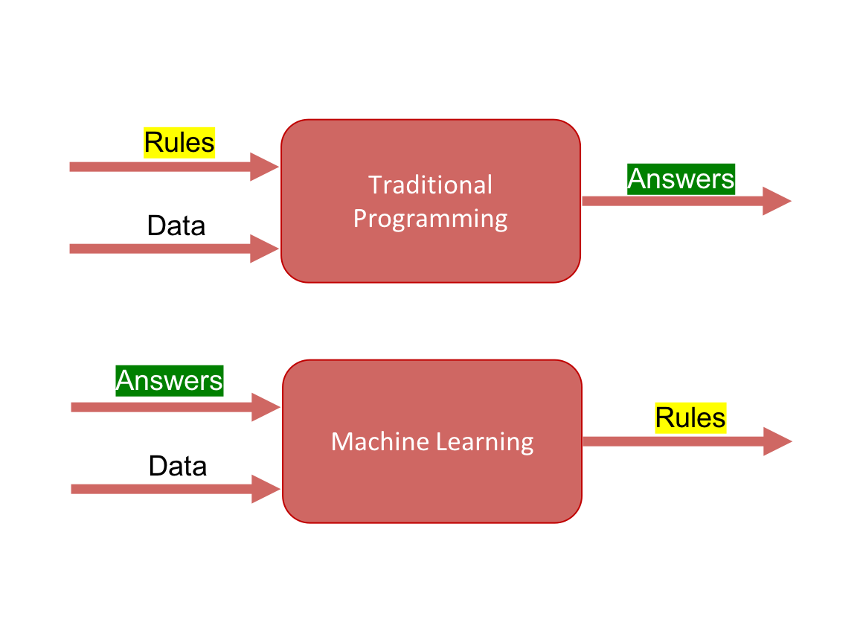
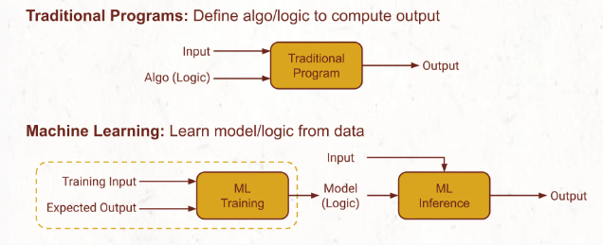
Traditional vs ML Programing

Slide 6
ML Related Fields
data
mining
control theory
statistics
machine
learning
decision theory
information theory
cognitive science
databases
psychological models
Machine learning is primarily concerned with the accuracy and effectiveness of the computer system.
evolutionary
models
neuroscience

Slide 7
ML Applications
Fraud detection.
Web search results.
Real-time ads on web pages
Credit scoring.
Prediction of equipment failures.
New pricing models.
Network intrusion detection.
Recommendation Engines
Customer Segmentation
Text Sentiment Analysis
Customer Churn
Pattern and image recognition.
Email spam filtering.

Slide 8
Types of ML
Supervised Machine Learning
Unsupervised Machine Learning
Semi-Supervised Machine Learning
Reinforcement Machine Learning

Slide 9
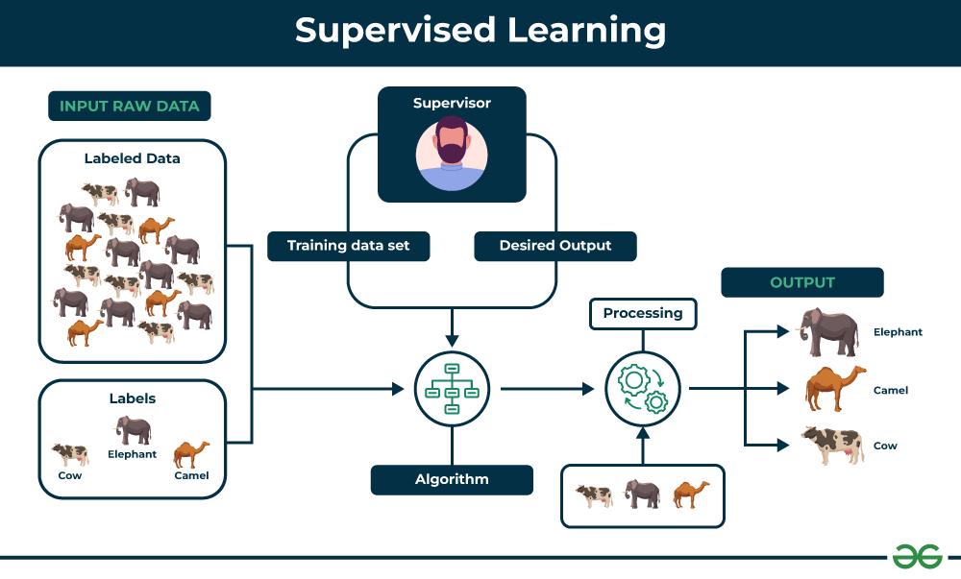
Supervised Machine Learning
Model gets trained on a “Labelled Dataset”
High accuracy as they are trained on labelled data
Can be time-consuming and costly as it relies on labeled data only
Two main categories
Classification
Regression
Labeled: America
Labelled: British

Slide 10
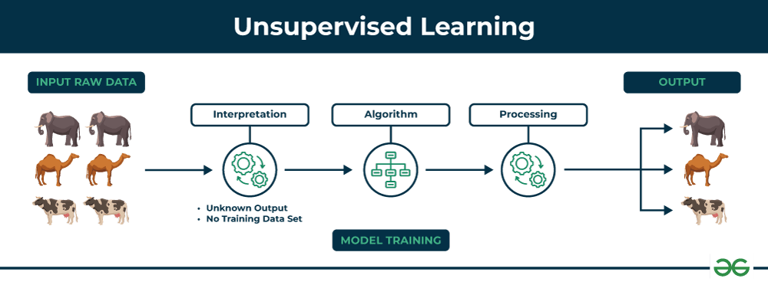
Unsupervised Machine Learning
Algorithm discovers patterns and relationships using unlabeled data
Discover hidden patterns, similarities, or clusters within the data
Without using labels, it may be difficult to predict the quality of the model’s output
Two main categories
Clustering
Association

Slide 11
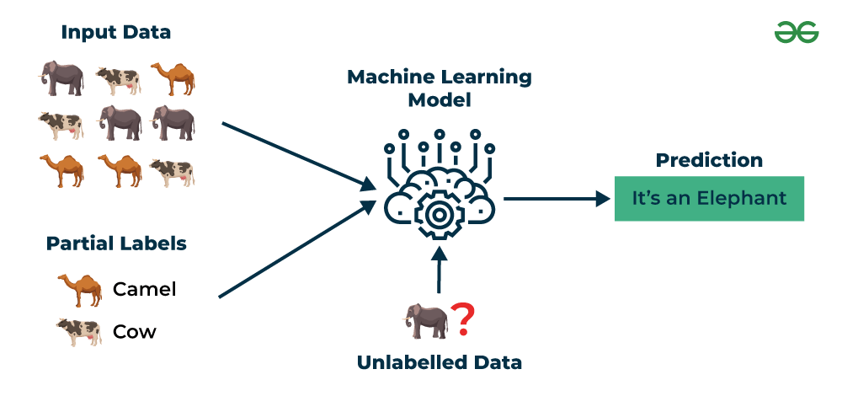
Semi-Supervised Machine Learning
Works between the supervised and unsupervised learning so it uses both labelled and unlabelled data
Useful when obtaining labeled data is costly, time-consuming, or resource-intensive
Example: Image and Speech Analysis

Slide 12
Algorithms
Supervised
Unsupervised
Classification
Logistic Regression
Support Vector Machine
Random Forest
Decision Tree
K-Nearest Neighbors (KNN)
Naive Bayes
Regression
Linear Regression
Polynomial Regression
Ridge Regression
Lasso Regression
Decision tree
Random Forest
Clustering
K-Means Clustering algorithm
Mean-shift algorithm
DBSCAN Algorithm
Principal Component Analysis
Independent Component Analysis
Association
Apriori Algorithm
Eclat
FP-growth Algorithm

Slide 13
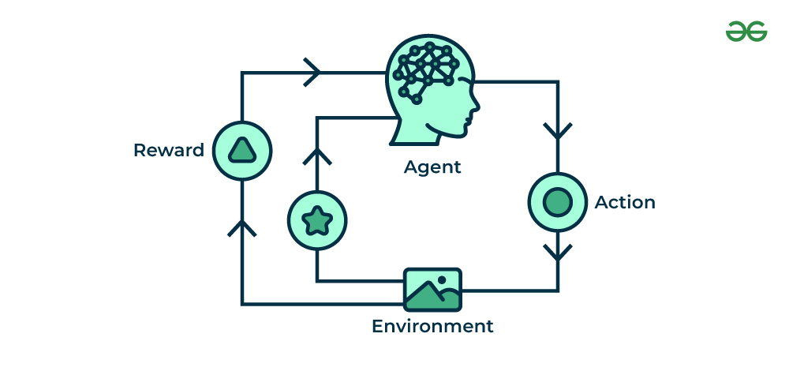
Reinforcement Machine Learning
Interacts with the environment by producing actions and discovering errors.
Trial, error, and delay are the most relevant characteristics
Popular Algorithm
Q-learning
SARSA (State-Action-Reward-State-Action)
Deep Q-learning

Slide 14
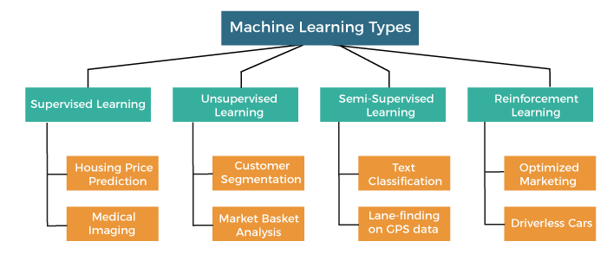

Slide 15
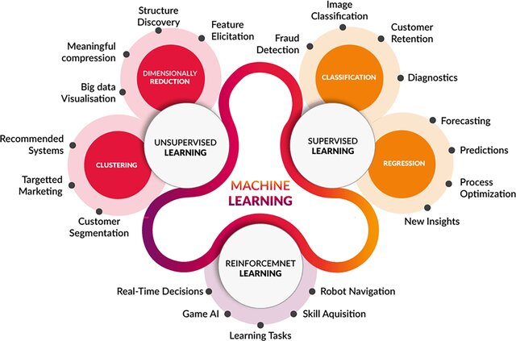
ML Applications

Slide 16
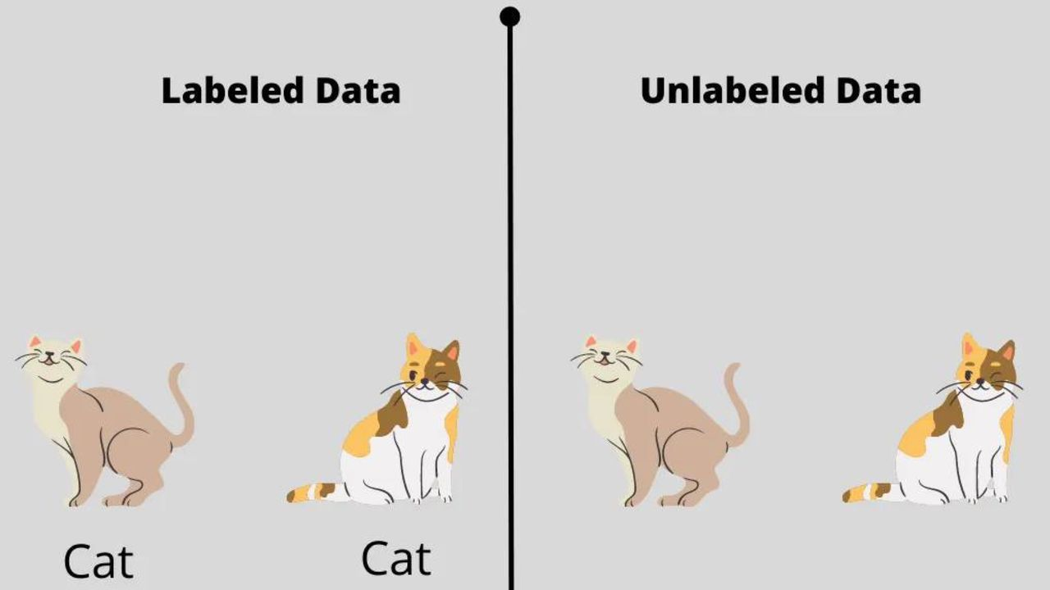
Feature
Photo No | Tail length (cm) | neck length (cm) | Has horn? | Is Giraffe?
1 | 5 | 8 | Yes | Yes
2 | 2 | 3 | No | No
3 | 1 | 2 | No | No
4 | 0 | 2 | No | No
Measurable property or unique characteristic of a phenomenon
Except labelled all other are feature data (may take part of)
Labelled data (Output is given)
Unlabelled data (Output is not given)

Slide 17
Supervised Learning Problem
Pizza size (in inch) | Pizza price (in taka)
6 | 399
9 | 699
12 | 1000
Pizza price prediction (regression problem)
Finding whether the animal is Giraffe (classification problem)
Train the machine using data and then do predict based on the learning

Slide 18
Criteria | Labeled Data | Unlabeled Data
Definition | Data with both input features and corresponding output labels | Data with only input features and no output labels
Usage | Primarily used in supervised learning | Primarily used in unsupervised learning
Application | Train models to predict or classify based on input data | Find patterns, groupings, or structures without predefined labels
Annotation | Annotated with correct answers | No annotations or labels
Example | Images labeled with categories like "cat," "dog" | Images without any category labels
Cost and Effort | More expensive and time-consuming due to the need for manual annotation | Easier and cheaper to collect
Supervised Learning | Essential for training models | Not used directly in training models
Unsupervised Learning | Not applicable | Essential for discovering patterns and structures
Importance | Helps in learning the relationship between input and output | Helps in uncovering hidden patterns and relationships

Slide 19
Supervised Machine Learning Process (1)
Test
Data
Model
Training &
Building
Data
Acquisition
Data
Cleaning
Model
Testing
Model
Deployment

Slide 20
Supervised Machine Learning Process (2)
Get your data! Customers, Sensors, etc...
Data
Acquisition

Slide 21
Supervised Machine Learning Process (3)
Clean and format your data (using Pandas)
Data
Acquisition
Data
Cleaning

Slide 22
Supervised Machine Learning Process (4)
Test
Data
Model
Training &
Building
Data
Acquisition
Data
Cleaning

Slide 23
Supervised Machine Learning Process (5)
Test
Data
Model
Training &
Building
Data
Acquisition
Data
Cleaning
Model
Testing

Slide 24
Supervised Machine Learning Process (6)
Test
Data
Model
Training &
Building
Data
Acquisition
Data
Cleaning
Model
Testing
Adjust
Model
Parameters

Slide 25
Parameters
Model parameters
Internal to the model
Essential for making prediction
Dependent on dataset
Example: weight/coefficient of independent variables in linear regression
Hyperparameters
Essential for optimizing model performance
External for model
Set manually by ML engineer
Not dependent on dataset
Example: kernel and slack in SVM, value of k in KNN, depth of tree in decision tree

Slide 26
Supervised Machine Learning Process (7)
Test
Data
Model
Training &
Building
Data
Acquisition
Data
Cleaning
Model
Testing
Model
Deployment

Slide 27




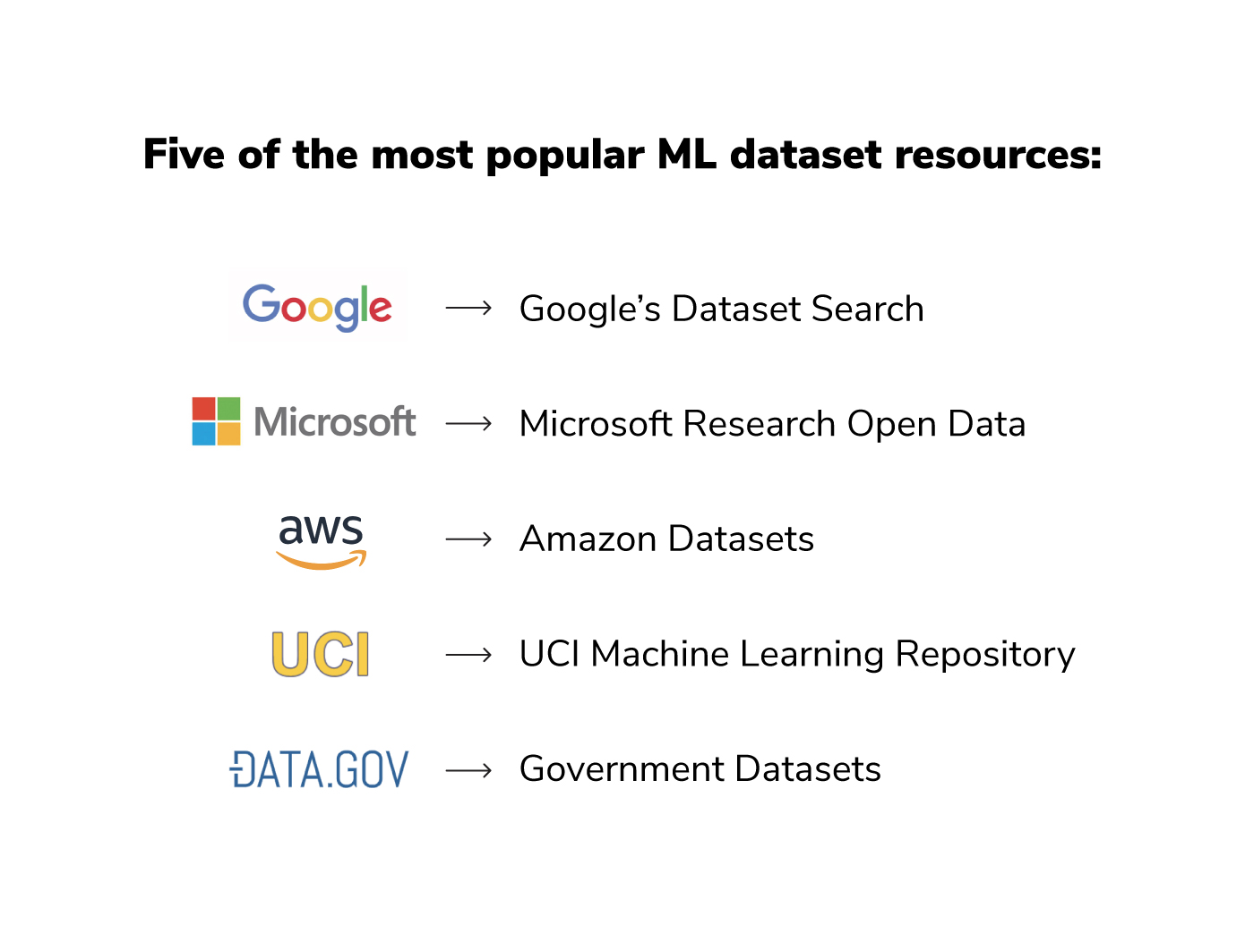



ML Data Sources

Slide 28
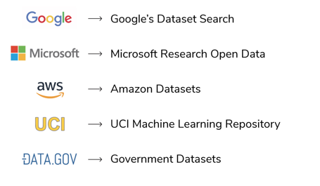
Popular Data Sources

Slide 29

Why Data Cleaning/Preprocessing?
Data in the real world is dirty
incomplete: lacking attribute values, lacking certain attributes of interest, or containing only aggregate data
noisy: containing errors or outliers
inconsistent: containing discrepancies in codes or names
No quality data, no quality mining results!
Quality decisions must be based on quality data
Data warehouse needs consistent integration of quality data
Cleaning, preprocessing, preparing
Data is an important task to be able to
Develop effective ML frameworks

Slide 30
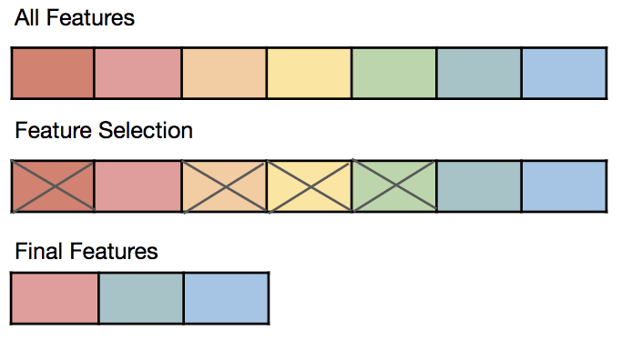
Data Reduction Strategies
Data reduction: Obtain a reduced representation of the data set that is much smaller in volume. But produces the same (or almost the same) analytical results
Why data reduction?
A database/data warehouse may store terabytes of data. Complex data analysis may take a very long time to run on the complete data set.
Data reduction strategies
Dimensionality reduction, e.g., remove unimportant attributes
Principal Components Analysis (PCA)
Feature subset selection, feature creation/extraction
Compression, Sampling, Aggregation, Filtering, Transformation, …

Slide 31
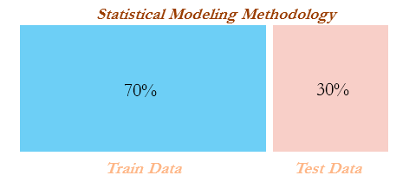
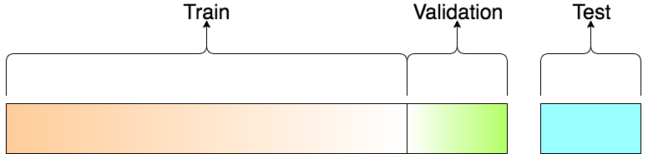
Data Splitting
Training Data
Used to train model parameters
Validation Data
Used to determine what model hyperparameters to adjust
Test Data
Used to get some final performance metric

Slide 32

Cross-validation
Rahim’s exam preparation
Questions covered from know/unknown chapters
Result: good/bad
Is he a good/bad student?

Slide 33
K-Fold Cross Validation
Divide the dataset into K chunks (i.e., folds) and train K times, using a different fold for each time.
E.g., Assume K=5
Dataset
Fold 1
Fold 2
Fold 3
Fold 4
Fold 5
1
Test
Train
Train
Train
Train
2
Train
Test
Train
Train
Train
3
Train
Train
Test
Train
Train
4
Train
Train
Train
Test
Train
5
Train
Train
Train
Train
Test
33
Notes:
To create the various testing and training data required to construct the supervised classification models, we employed k-fold cross validation.
With this method, the original dataset is first divided into K equal-size chunks or folds…
Advantages: (Better use of data and validates performance on multiple folds)
Aim of cross validation is to ensure that every example from the data set has an equal chance of appearing in the training and testing set.
As the value of K increases the variance of the resulting estimate is reduced
K-fold CV often give more accurate estimate of the test error rate
Disadvantages: (CPU Time)
The training algorithm has to be rerun from scratch k times..
Which means it takes k times as much computation to make an evaluation

Slide 34
K-Fold Cross Validation
Final Model Evaluation: (S1 + S2 + S3 + S4 + S5) / 5
Iteration (1 to K) | Training Set | Test Set | Performance Score
1 | D2, D3, D4, D5 | D1 | S1
2 | D1, D3, D4, D5 | D2 | S2
3 | D1, D2, D4, D5 | D3 | S3
4 | D1, D2, D3, D5 | D4 | S4
5 | D1, D2, D3, D4 | D5 | S5

Slide 35
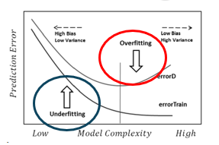
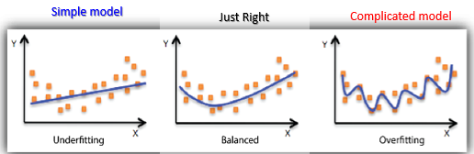
Overfitting and Underfitting
Underfitting: Poor performance on the training data and poor generalization to other (unseen) data
Overfitting: Good performance on training data but poor generalization to other (unseen) data (memorizing!!)

Slide 36
Performance Metrics/Model Evaluation
Key Classification Problem
Confusion Matrix (not a metric)
Accuracy
Precision
Recall
F1-Score
Regression Problem
Mean Absolute Error (MAE)
Mean Squared Error (MSE)
R-squared (R²) Value
Root Mean Squared Error (RMSE)
Clustering
Elbow Method (not a performance metric but used to find optimal number of K cluster)

Slide 37
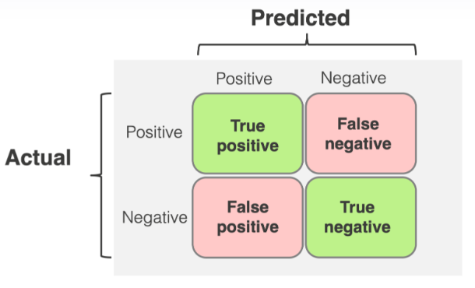
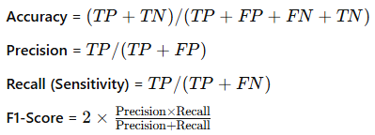
Confusion Matrix (not a metric)
It is also called as error matrix
It is an N x N matrix, where N is the number of target labels (classes)
It shows the number of correct and incorrect predictions made by the classifier compared to the actual outcomes (target labels) in the actual data
E.g., binary classification problem (e.g., two classes 0|1 or T|F)

Slide 38
Model Evaluation
But first, we should understand the reasoning behind these metrics and how they will actually work in the real world!

Slide 39
Model Evaluation
Typically in any classification task your model can only achieve two results:
Either your model was correct in its prediction.
Or your model was incorrect in its prediction.

Slide 40
Model Evaluation
Fortunately incorrect vs correct expands to situations where you have multiple classes.
For the purposes of explaining the metrics, let’s imagine a binary classification situation, where we only have two available classes.

Slide 41
Model Evaluation
In our example, we will attempt to predict if an image is a dog or a cat.
Since this is supervised learning, we will first fit/train a model on training data, then test the model on testing data.
Once we have the model’s predictions from the X_test data, we compare it to the true y values (the correct labels).

Slide 42
Model Evaluation
TRAINED
MODEL

Slide 43
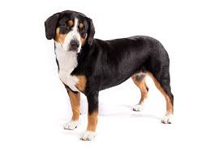
Model Evaluation
TRAINED
MODEL
Test Image
from X_test

Slide 44
Model Evaluation
TRAINED
MODEL
Test Image
from X_test
DOG
Correct Label
from y_test

Slide 45
Model Evaluation
TRAINED
MODEL
Test Image
from X_test
DOG
Prediction on
Test Image
DOG
Correct Label
from y_test

Slide 46
Model Evaluation
TRAINED
MODEL
Test Image
from X_test
DOG
Prediction on
Test Image
DOG
Correct Label
from y_test
DOG == DOG ?
Compare Prediction to Correct Label

Slide 47
Model Evaluation
TRAINED
MODEL
Test Image
from X_test
CAT
Prediction on
Test Image
DOG
Correct Label
from y_test
DOG == CAT ?
Compare Prediction to Correct Label

Slide 48
Model Evaluation
We repeat this process for all the images in our X test data.
At the end we will have a count of correct matches and a count of incorrect matches.
The key realization we need to make, is that in the real world, not all incorrect or correct matches hold equal value!

Slide 49
Model Evaluation
Also in the real world, a single metric won’t tell the complete story!
To understand all of this, let’s bring back the 4 metrics we mentioned and see how they are calculated.
We could organize our predicted values compared to the real values in a confusion matrix.

Slide 50
Model Evaluation
Accuracy
Accuracy in classification problems is the number of correct predictions made by the model divided by the total number of predictions.

Slide 51
Model Evaluation
Accuracy
For example, if the X_test set was 100 images and our model correctly predicted 80 images, then we have 80/100.
0.8 or 80% accuracy.

Slide 52
Model Evaluation
Accuracy
Accuracy is useful when target classes are well balanced
In our example, we would have roughly the same amount of cat images as we have dog images.

Slide 53
Model Evaluation
Accuracy
Accuracy is not a good choice with unbalanced classes!
Imagine we had 99 images of dogs and 1 image of a cat.
If our model was simply a line that always predicted dog we would get 99% accuracy!

Slide 54
Model Evaluation
Accuracy
Imagine we had 99 images of dogs and 1 image of a cat.
If our model was simply a line that always predicted dog we would get 99% accuracy!
In this situation we’ll want to understand recall and precision

Slide 55
Model Evaluation
Recall/Sensitivity
TP/(TP+FN)
Ability of a model to find all the relevant cases within a dataset.
The precise definition of recall is the number of true positives divided by the number of true positives plus the number of false negatives.

Slide 56
Model Evaluation
Assume, a data set of 100 possible cancer patients whose only 10 patients have really cancer
Recall: TP/(TP+FN)
Let, our model identified 5 patients have cancer. So, True Positive = 5, False Negative = 5
Recall = 5/10 = .5 = 50 %
Recall works on false negative- finds the number of unidentified real cancer patients

Slide 57
Model Evaluation
Precision
Ability of a classification model to identify only the relevant data points.
Precision is defined as the number of true positives divided by the number of true positives plus the number of false positives.

Slide 58
Model Evaluation
Assume, a data set of 100 possible cancer patients whose only 5 patients have really cancer
Precision: TP/(TP+FP)
Let, our model predicted all100 patients have cancer. So, True Positive + False Positive = 100
But only 5 patients have cancer. True Positive = 5
Precision = 5/100 = .05 = 5%
Precision works on false positive- finds the number of real cancer patients

Slide 59
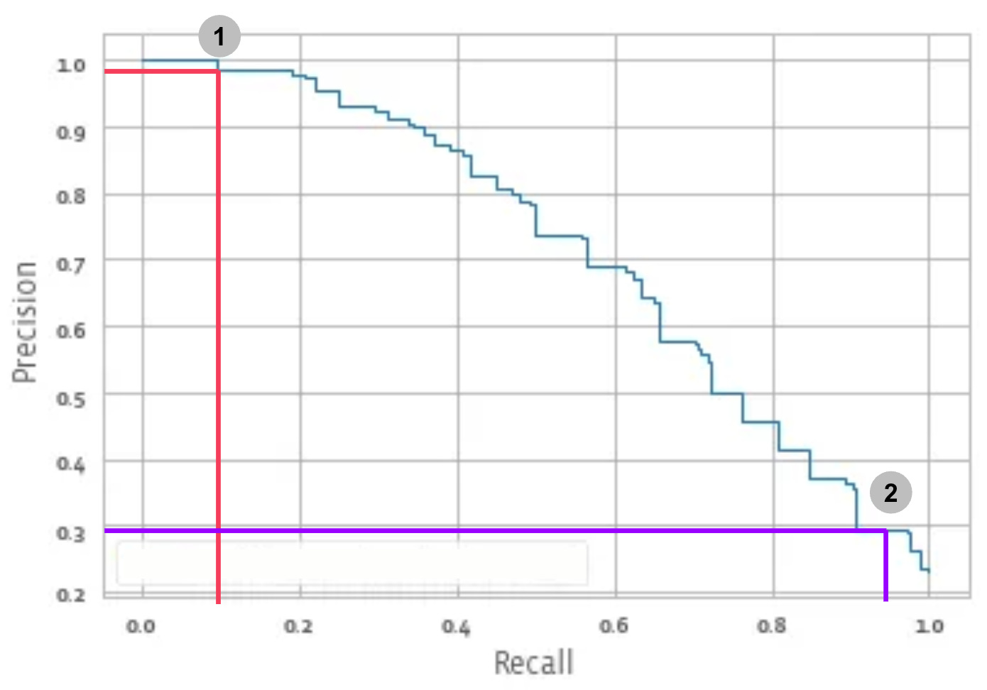
Model Evaluation: Recall and Precision
Often you have a trade-off between Recall and Precision.
While recall expresses the ability to find all relevant instances in a dataset, precision expresses the proportion of the data points our model says was relevant were relevant.

Slide 60
Model Evaluation
F1-Score
In cases where we want to find an optimal blend of precision and recall we can combine the two metrics using what is called the F1 score.

Slide 61
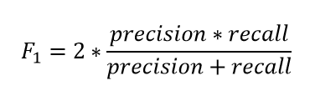
Model Evaluation
F1-Score
The F1 score is the harmonic mean of precision and recall taking both metrics into account in the following equation:

Slide 62
Model Evaluation
F1-Score
We use the harmonic mean instead of a simple average because it punishes extreme values.
A classifier with a precision of 1.0 and a recall of 0.0 has a simple average of 0.5 but an F1 score of 0.

Slide 63
Model Evaluation
The main point to remember with the confusion matrix and the various calculated metrics is that they are all fundamentally ways of comparing the predicted values versus the true values.
What constitutes “good” metrics, will really depend on the specific situation!
Math &
Statistics
Machine Learning
DS
Software
Research
Domain
Knowledge

Slide 64
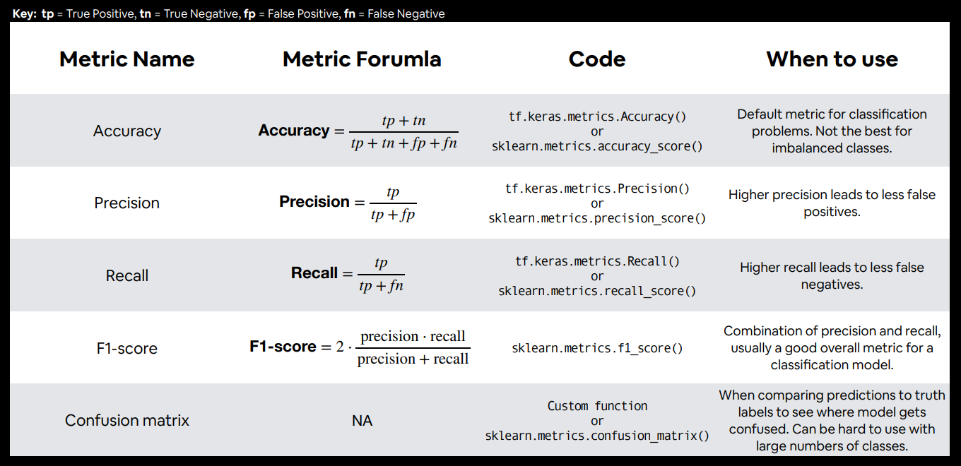
Performance Metrics/Model Evaluation

Slide 65
Evaluating Performance
REGRESSION

Slide 66
Evaluating Regression
Let’s take a moment now to discuss evaluating Regression Models
Regression is a task when a model attempts to predict continuous values (unlike categorical values, which is classification)

Slide 67
Evaluating Regression
You may have heard of some evaluation metrics like accuracy or recall.
These sort of metrics aren’t useful for regression problems, we need metrics designed for continuous values!

Slide 68
Evaluating Regression
For example, attempting to predict the price of a house given its features is a regression task.
Attempting to predict the country a house is in given its features would be a classification task.

Slide 69
Evaluating Regression
Most common evaluation metrics:
Mean Absolute Error (MAE)
Mean Squared Error (MSE)
Root Mean Square Error (RMSE)

Slide 70
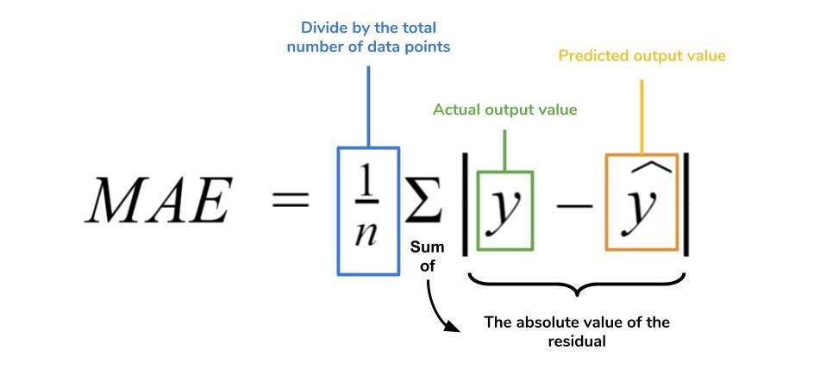
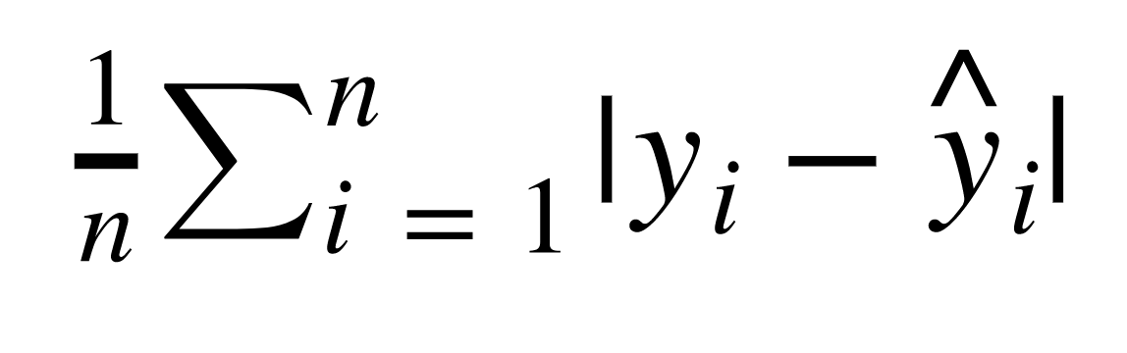
Evaluating Regression
Mean Absolute Error (MAE)
This is the mean of the absolute value of errors.
Easy to understand

Slide 71
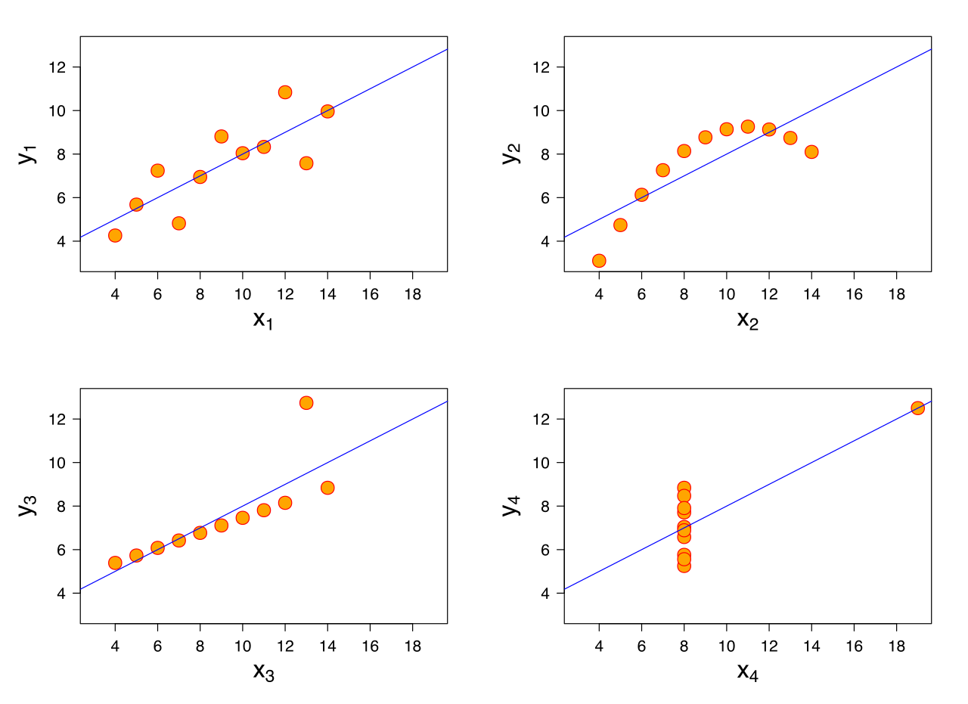
Evaluating Regression
MAE won’t punish large errors however.

Slide 72
Evaluating Regression
MAE won’t punish large errors however.

Slide 73
Evaluating Regression
We want our error metrics to account for these!

Slide 74
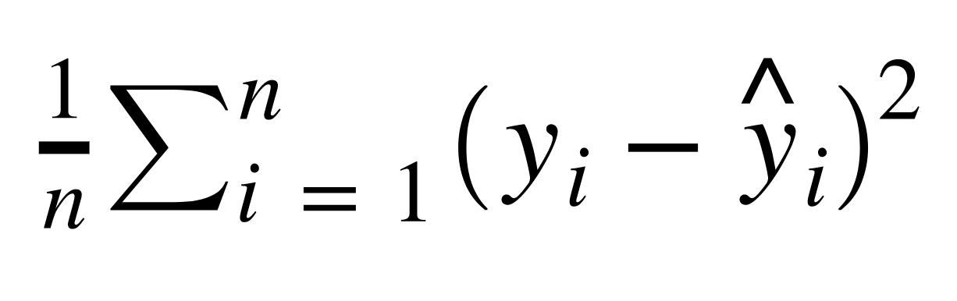
Evaluating Regression
Mean Squared Error (MSE)
This is the mean of the squared errors.
Larger errors are noted more than with MAE, making MSE more popular.

Slide 75
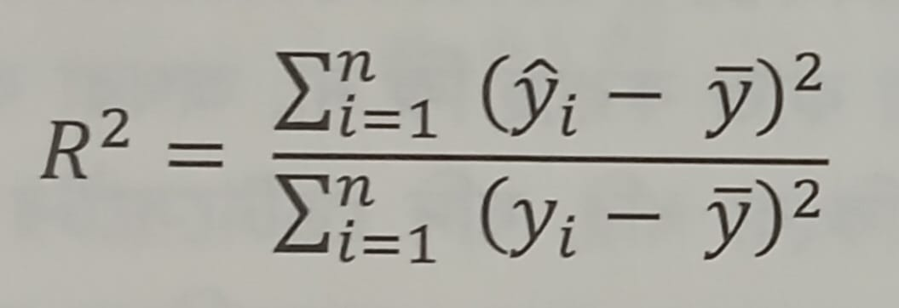
Evaluating Regression: R-squared (R²) Value/Score
Y bar: mean of all real values
As value close to 1 the model performed better

Slide 76
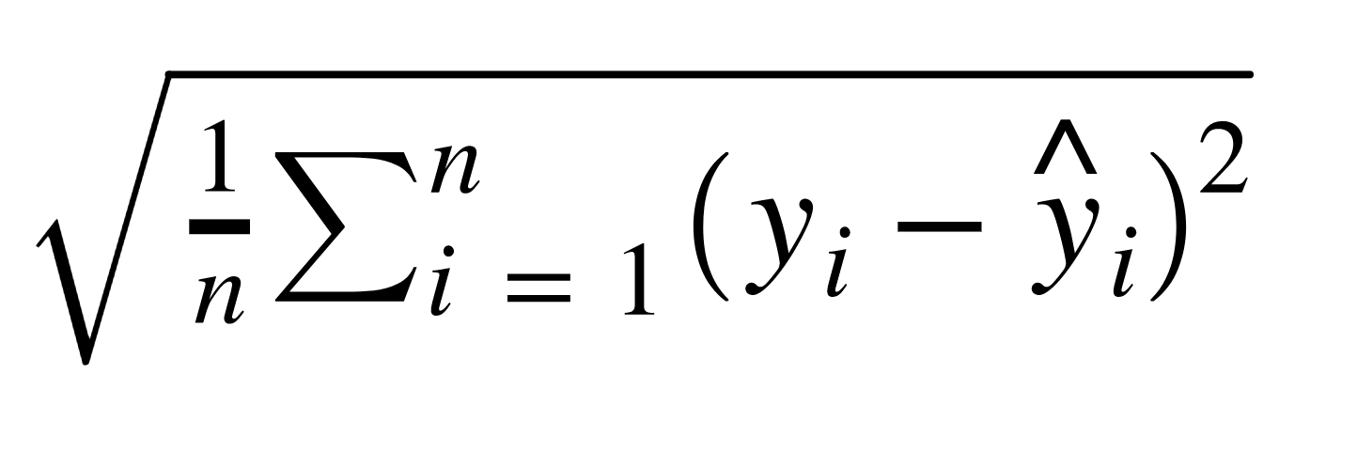
Evaluating Regression
Root Mean Square Error (RMSE)
This is the root of the mean of the squared errors.
Most popular (has same units as y)

Slide 77
Machine Learning
Most common question from students:
“Is this value of RMSE good?”
Context is everything!
A RMSE of $10 is fantastic for predicting the price of a house, but horrible for predicting the price of a candy bar!

Slide 78
Machine Learning
Compare your error metric to the average value of the label in your data set to try to get an intuition of its overall performance.
Domain knowledge also plays an important role here!

Slide 79
Unsupervised Learning

Slide 80
Machine Learning
We’ve covered supervised learning, where the label was known due to historical labeled data.
But what happens when we don’t have historical labels?

Slide 81
Machine Learning
There are certain tasks that fall under unsupervised learning:
Clustering
Anomaly Detection
Dimensionality Reduction

Slide 82
Machine Learning
Clustering
Grouping together unlabeled data points into categories/clusters
Data points are assigned to a cluster based on similarity

Slide 83
Machine Learning
Anomaly Detection
Attempts to detect outliers in a dataset
For example, fraudulent transactions on a credit card.

Slide 84
Machine Learning
Dimensionality Reduction
Data processing techniques that reduces the number of features in a data set, either for compression, or to better understand underlying trends within a data set.

Slide 85
Machine Learning
Unsupervised Learning
It’s important to note, these are situations where we don’t have the correct answer for historical data!
Which means evaluation is much harder and more nuanced!

Slide 86
Unsupervised Process
Test
Data
Model
Training &
Building
Data
Acquisition
Data
Cleaning
Transformation
Model
Deployment

Slide 87
References
If not indicated, otherwise google image
Foundations of Data Science with Python by John M. Shea
Python Data Science Handbook by Jake VanderPlas
Python Basics: A Practical Introduction to Python 3 by David Amos Dan, Joanna Jablonski, Fletcher Heisler
Internet Resources (geeksforgeeks, tutorialpoint, w3schools, datacamp)
Online Courses (Udemy, Udacity, Coursera, Harvard eduX)

